Slide 1
Data Structure & Algorithm
Course: Data Structure and Algorithm (3-0-1)
Course Code: CMP 224.3
Lecture Hour : 48 hrs.
Methods of teaching: lecture, presentation demo and lab.
Evaluation: 50+50(External written exam and internal lab(20) and exam, CP, DR, Assessment (30))

Slide 2
UNIT ONE: INTRODUCTION
In this unit we will discuss about following topics
Introduction of DSA,
Abstract Data Types(ADTs) &its scope,
Data structure and its types,
Brief introduction to Recursion
Data Structure BY S.R. Sharma

Slide 3
1. Introduction of DSA
Data structure is representation of the logical relationship existing between individual elements of data.
In other words “a data structure is a way of organizing all data items that considers not only the elements stored but also their relationship to each other”
Data structure mainly specify following four things, they are
Data Structure BY S.R. Sharma

Slide 4
Cont..
Organization of data.
Accessing methods
Degree of associativity
Processing alternatives for information
Data structure are the building block of the program and hence selection of particular data structure stresses on the following two things.
1. The data structure must be rich enough in structure to reflect the relationship existing between the data
Data Structure BY S.R. Sharma

Slide 5
Cont..
2. And the structure should be simple so that we can process the data effectively wherever required.
The data structure affects the design of both structure and functional aspect of a program.
Algorithm + Data Structure = Program
Algorithm and the best design of data structure yields a good program
Data Structure BY S.R. Sharma

Slide 6
Algorithm
An algorithm is a set of rules for carrying out calculation either by hand or on machine.
An algorithm is a sequence of computational steps that transform input into output
Algorithm is a step by step procedure to solve a particular problems/function. That is it is the set of instruction written to carry out certain task. Algorithms are mainly two types:
Data Structure BY S.R. Sharma

Slide 7
Cont..
1. Iterative (Repetitive): use loop and condition statements
2. Recursive: use divide and conquer method.
Algorithm must have the following properties
Input: An algorithm must receive some input data supplied externally.
Output: An algorithm must produce at least one output as the result
Data Structure BY S.R. Sharma

Slide 8
Cont..
Finiteness: the algorithm must terminate after a finite number of steps.
Definiteness: each step of the algorithm must be clear.
Effectiveness: one must be able to perform the steps in the algorithm without applying any intelligence.
Data Structure BY S.R. Sharma

Slide 9
Types of Data Structure
There are mainly two types of data structure they are as following
Primitive data structure
Non primitive data structure
Primitive data structure: these are basic structure and are directly operated upon by the machine instructions. These in general, have different representation on different computer. int float, char, string and pointer fall in this category.
Data Structure BY S.R. Sharma

Slide 10
Cont..
Non-primitive data structure: these are more sophisticated data structures, there are derived from the primitive data structure. Non- primitive data structure emphasize on structuring of a group of homogeneous or heterogeneous data items. Array lists, and files are examples.
In non-primitive data types we can perform the sets of operations on it so they are also called the ADT’s (abstract data types). The most common used operation on data structure are create, delete, insert, update and search.
Data Structure BY S.R. Sharma

Slide 11
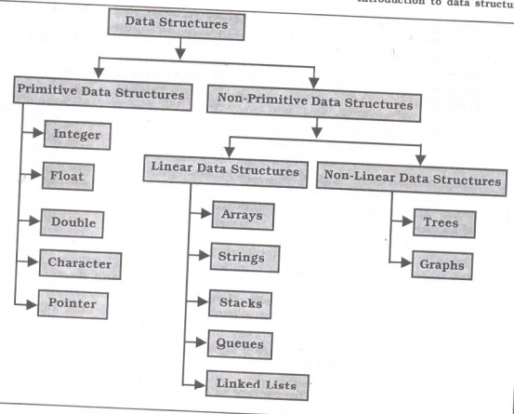
Data Structure BY S.R. Sharma

Slide 12
Brief introduction to Recursion
Recursion is defined as anything in terms of itself. Recursion is used to solve problems involving iterations (multiple execution),in reverse order. Recursion is an alternative to iteration in making a function execution repeatedly
Recurrence from the Latin, re= back+ currernce=to run to happen again, especially at repeated intervals.
Data Structure BY S.R. Sharma

Slide 13
Cont..
The technique is useful both for the definition of mathematical functions and for definition of data structures.
Data structures also may be recursively defined.
One of the most important classes of structure-tree allows recursive definition which lead to simple recursive function for manipulating them. Recursion: when a method call itself
Classic example: factorial function:
N!=1.2.3.4……(n-1).n
Recursive definition:
f(n)=1 and if n=0 else
f(n)=n*f(n-1)
Data Structure BY S.R. Sharma

Slide 14
Disadvantages of recursion
It consumes more storage space because the recursive calls along with automatic variables are stored on the stack.
the computer may run out of memory if recursive calls are not checked.
It is not more efficient in terms of speed and execution time.
Recursion does not offer any concrete advantages over other methods
Data Structure BY S.R. Sharma

Slide 15
Basic requirement/rules for recursion
For the implementing and design the good recursive program we must make certain assumptions as follows:
Base case: we must always have some base cases which can be solved with recursion.
Make progress: The recursive call must always be to a case that make progress towards a base case.
Design rule : Assume that all the recursive calls works.
Compound interest rule: Never duplicate works by solving the same instance of a problem in separate recursive calls.
Data Structure BY S.R. Sharma

Slide 16
TOH problem (Tower of Hanoi)
In this game there are three different sized of disks. Each disk has a hole in the center. So that is can be stacked on any of the pegs. Call three pegs as x,y, and z. At the beginning of the games, the disk are stack on the x pegs, that is the largest sized disk on the bottom and the smallest sized disk on top for n-3 disks
Data Structure BY S.R. Sharma

Slide 17
Rules of the games
Transferring the disks from the source peg to the destination peg such that at any points of transformation no larger size disk is placed on the smaller one.
Only one disk may be moved at a time.
Each disk must be stacked on any one of the pegs.
The process is as shown below.
Data Structure BY S.R. Sharma

Slide 18
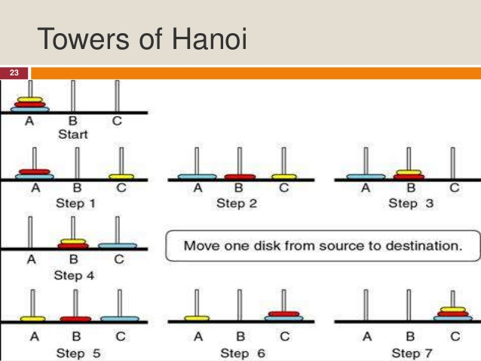
Data Structure BY S.R. Sharma

Slide 19
So the general solution is
If n==1 move the single disk from S to D and stop.
Move the top n-1 disks from S to T, using D as auxiliary.
Move the remaining disk from S to D.
Move the n-1 disks from T to D, using S as auxiliary.
Data Structure BY S.R. Sharma

Slide 20
Function for TOH.
tofh(int ndisk,char source,char temp, char dest)
{
if(ndisk>0)
{
tofh(ndisk-1,source,dest,temp);
printf("move disk %d %c->%c\n",ndisk,source,dest);
tofh(ndisk-1,temp,source,dest);
}
}
Data Structure BY S.R. Sharma

Slide 21
Assessments
Write a program using recursion function to print the factorial of given number.
Write a program using recursion function to display fibonnic series up to 50
Write a program using recursion to print the sum of natural number upto n.
Data Structure BY S.R. Sharma

Slide 22
THANK YOU
Data Structure BY S.R. Sharma

